Slide 1

고조선
Notes:
고조선

Slide 2

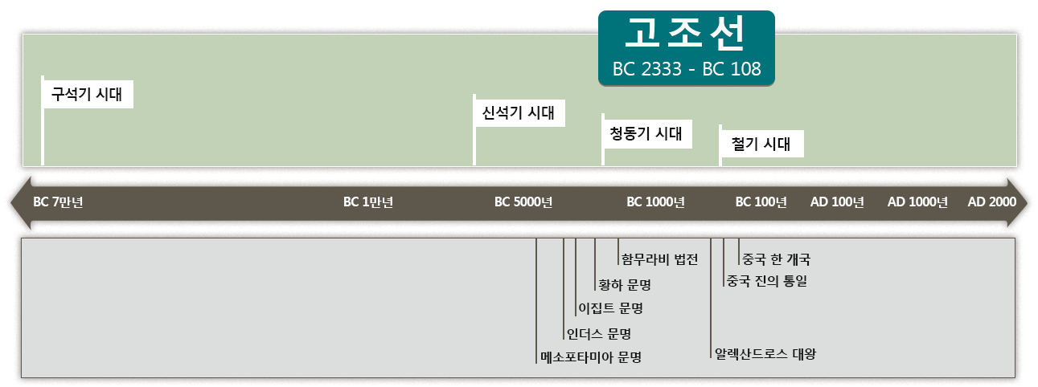
고조선과 세계사
Notes:
The first country on the Korean Peninsula was called 고조선. 고조선 was around from 2333 BC to 108 BC. It was established in the Bronze Age and lasted to the early Iron Age.
Look at this timeline, you can see the time when the Mesopotamian civilization, the Indus civilization, the Egyptian civilization, and the Yellow River civilization all emerged.

Slide 3
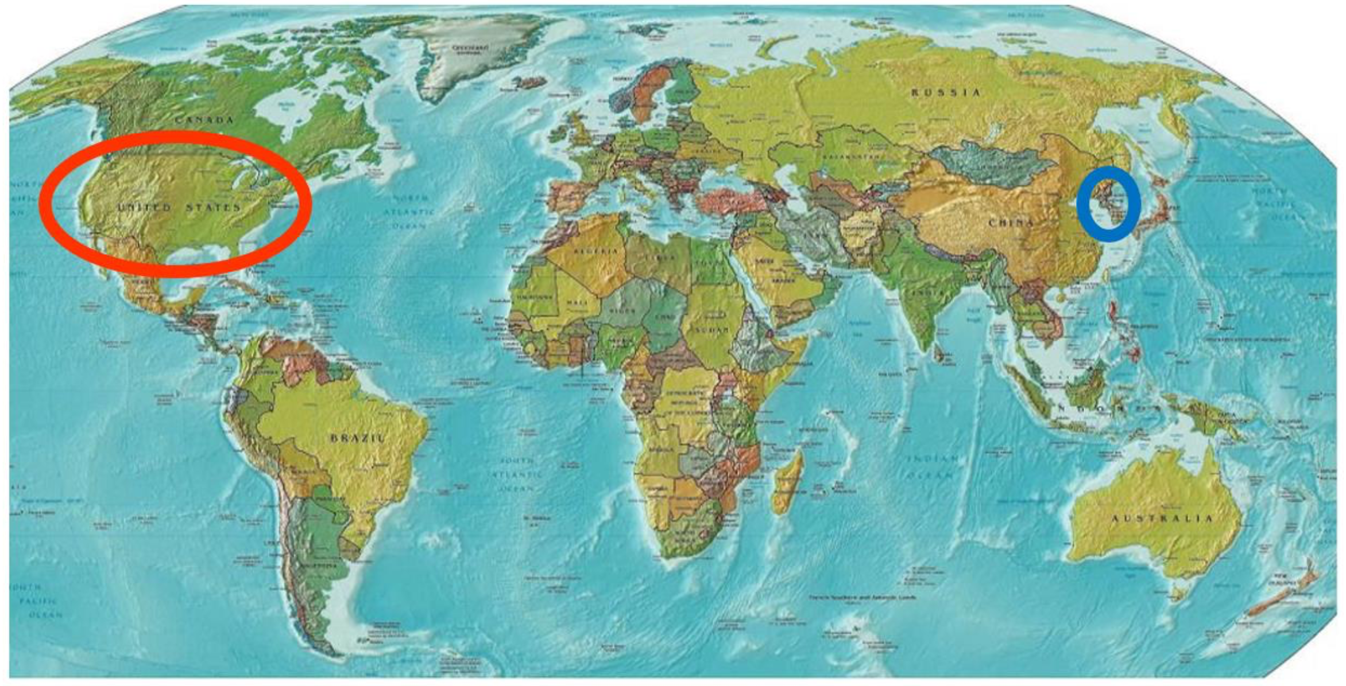
Notes:
Can you find Korea and the US on this map?

Slide 4
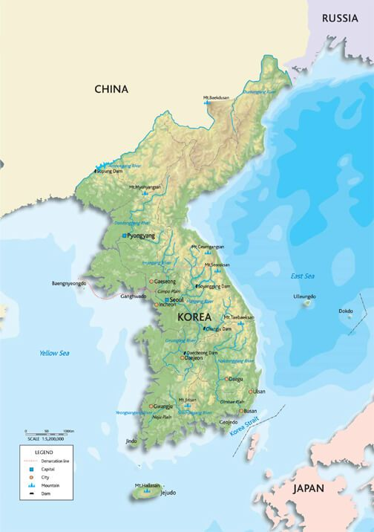
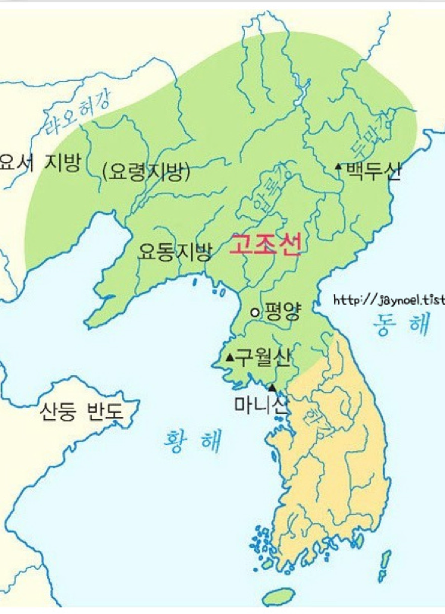

고조선
영역
고조선은
어디였을까?
Notes:
The map on the left is a map of South Korea and North Korea. The map on the right shows the territory of 고조선, the first country built on the Korean Peninsula. It covers South Korea, North Korea, and even further north.

Slide 5
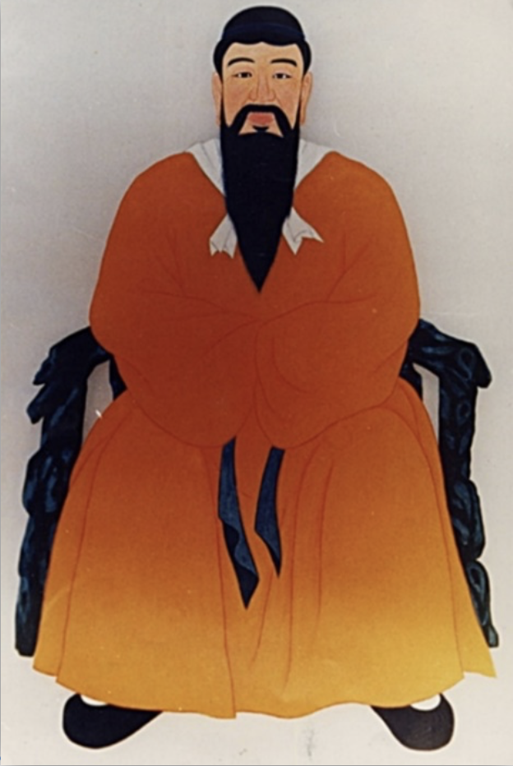
단군왕검
한민족의 신화적인 시조
고조선을 세운 국조
단군 : 제사장
왕검 : 지도자
Notes:
The person who founded 고조선 was called 단군왕검. '단군' means priest, and '왕검' means political leader. 단군왕검 doesn’t refer to one person but refers to the position or the title of a person who ruled 고조선.

Slide 6
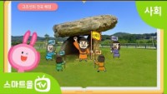
https://www.youtube.com/watch?v=9yDuYu5Mgs4&feature=emb_title
Notes:
Let’s watch the story of 단군왕검.
<click> (영상)
<click> The story tells us that people who were chosen by the heavens united with the bear-worshiping tribe and established 고조선, they also thought agriculture was very important.

Slide 7
건국이념
홍익인간
弘(넓을 홍) 益(더할 익) 人(사람 인) 間(사이 간)
널리 인간을 이롭게 한다
Notes:
The founding ideology of 고조선 is '홍익인간'. This means 'widely benefiting humans.'

Slide 8
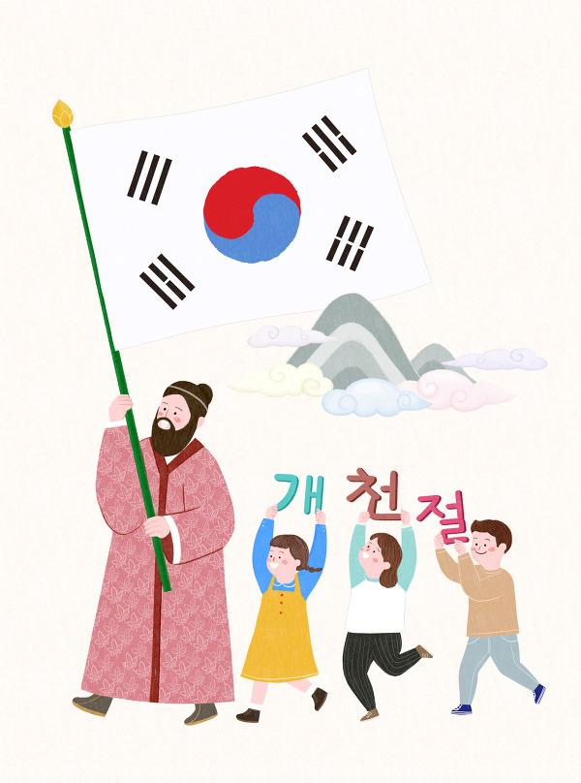

개천절은
10월 3일
개천절은
언제일까?
‘하늘이 열린 날’이라는 뜻
Notes:
The day to commemorate the establishment of 고조선 is called개천절, National Foundation Day. It is on October 3rd, and the name means the day the sky was opened.

Slide 9
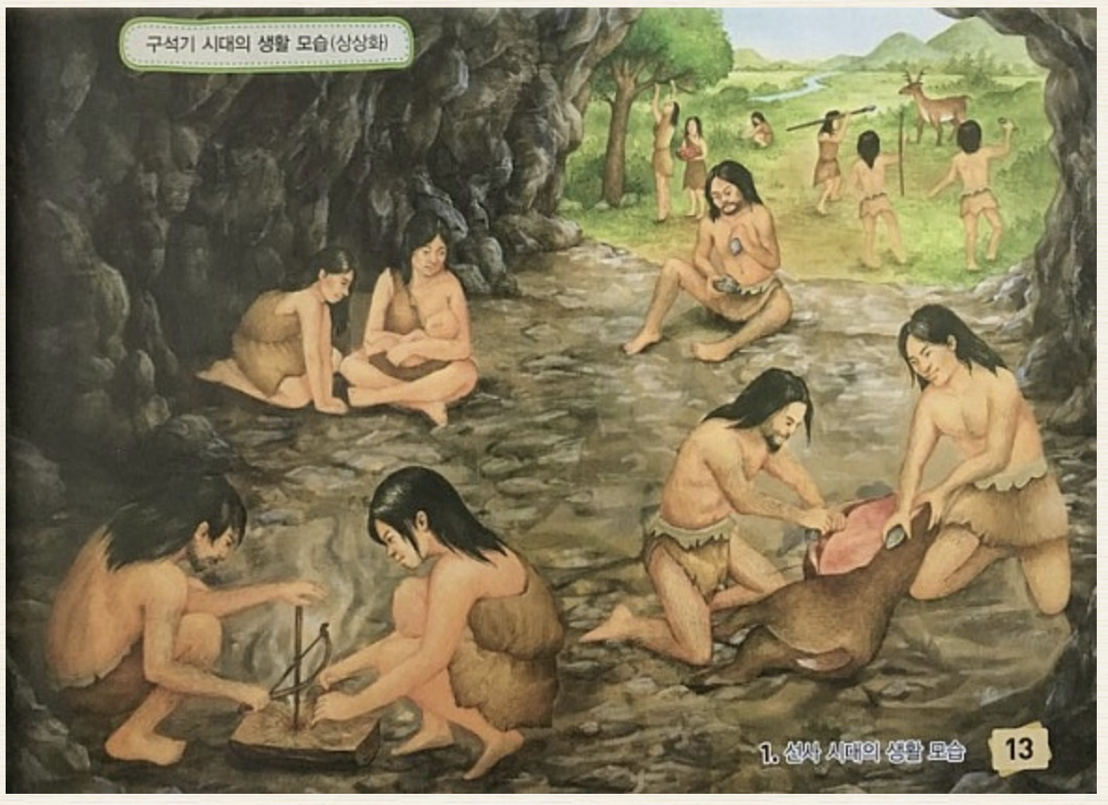
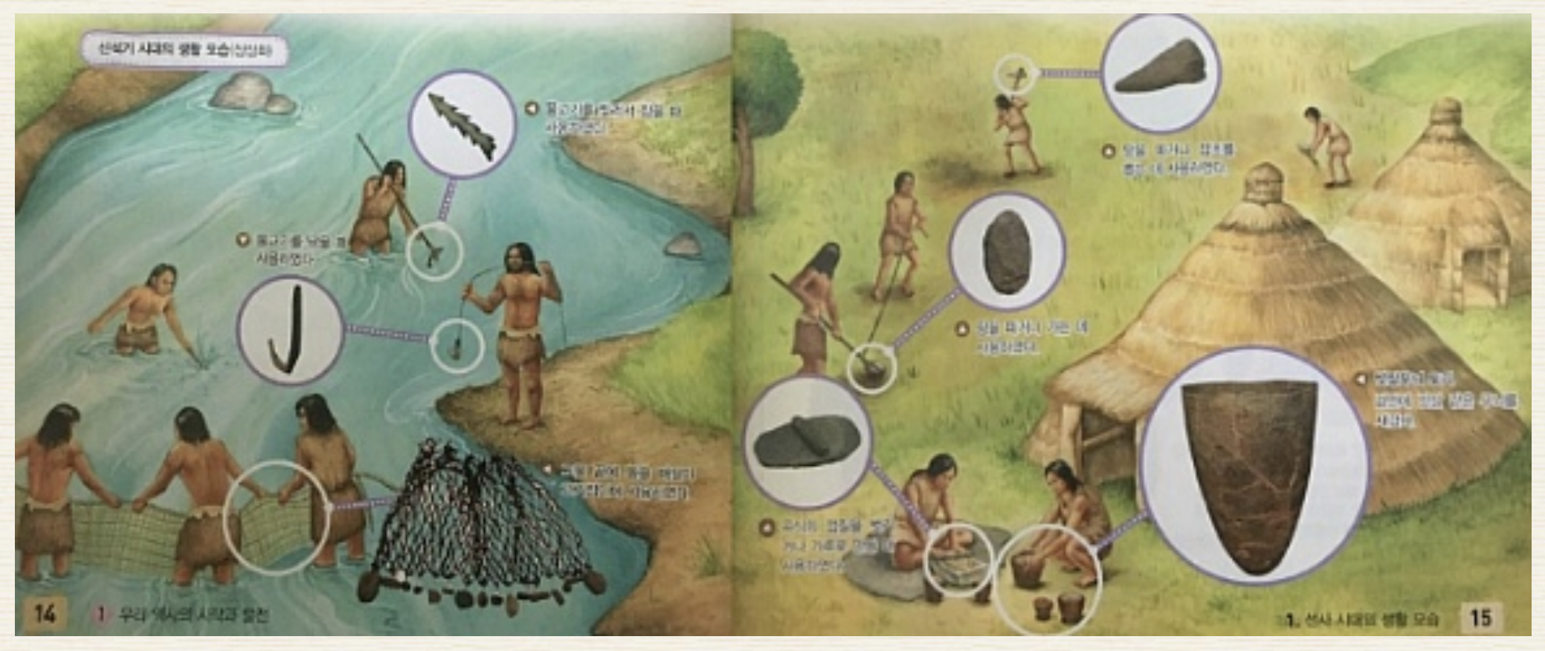
생활상
구석기
(The Old Stone Age)
700,000년 전
신석기
(The New Stone Age)
B.C. 8000년
무리를 지어 사는 모습
움집을 짓고 사는 모습
Notes:
Let's find out how people lived before 고조선 was founded? About 700,000 years ago, in the Paleolithic Age, people immigrated in search of food. They moved to caves, near places where there were many fruit trees and flowing water so that they could pick fruit and hunt small animals. When there was no food to eat, they moved to another place.
In the Neolithic Age, people settled near rivers and beaches. They farmed and raised animals in the community. And as the food situation improved, the population grew, and the people needed a leader to maintain order within the group.

Slide 10
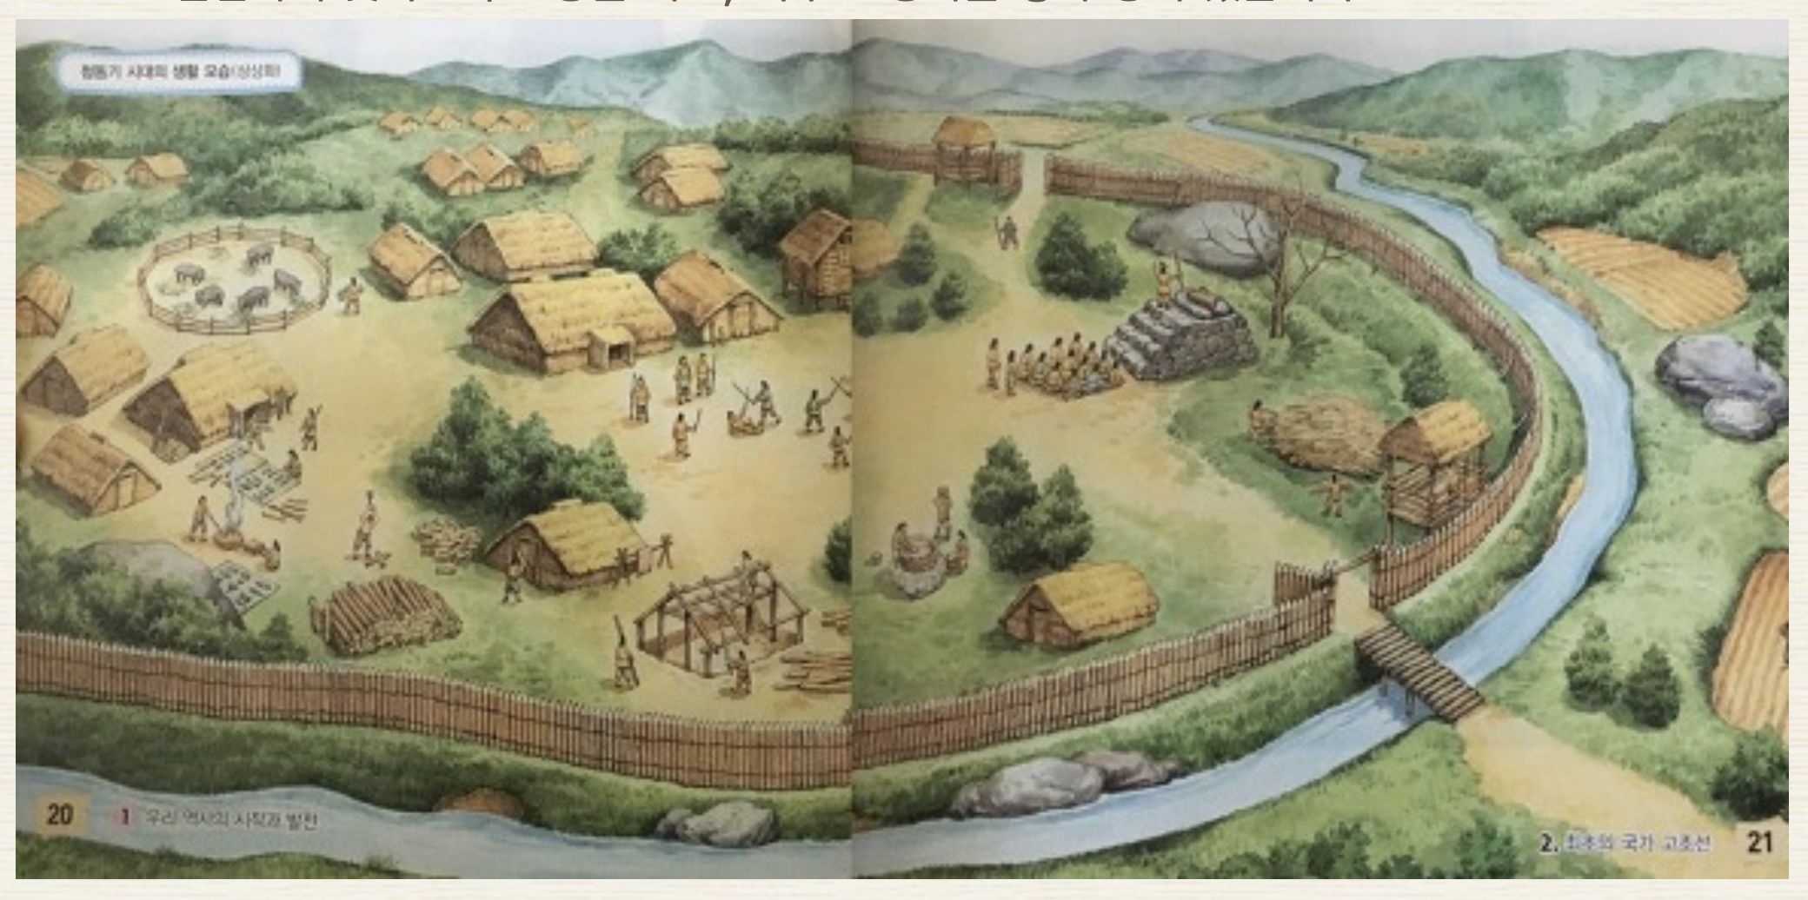
청동기 시대
(The Bronze Age)
B.C. 1000년
Notes:
In the Bronze Age, as farming techniques developed and the population grew, tribes began to fight for land. At this time, the tribes who used bronze swords grew in power. 고조선 was a country built on the basis of this Bronze Age.

Slide 11
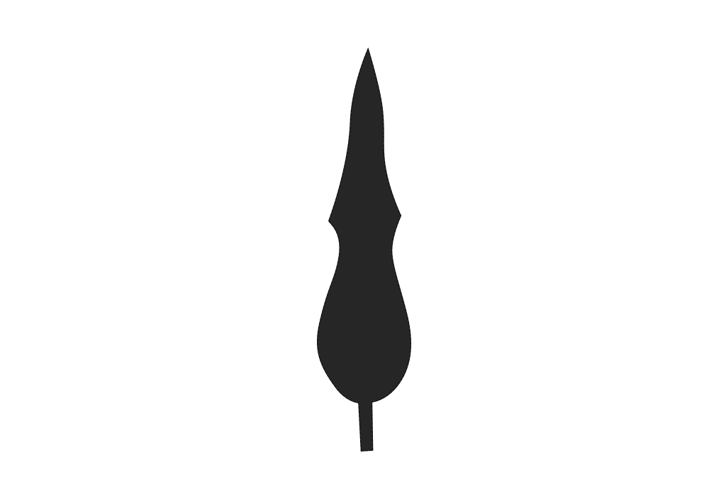
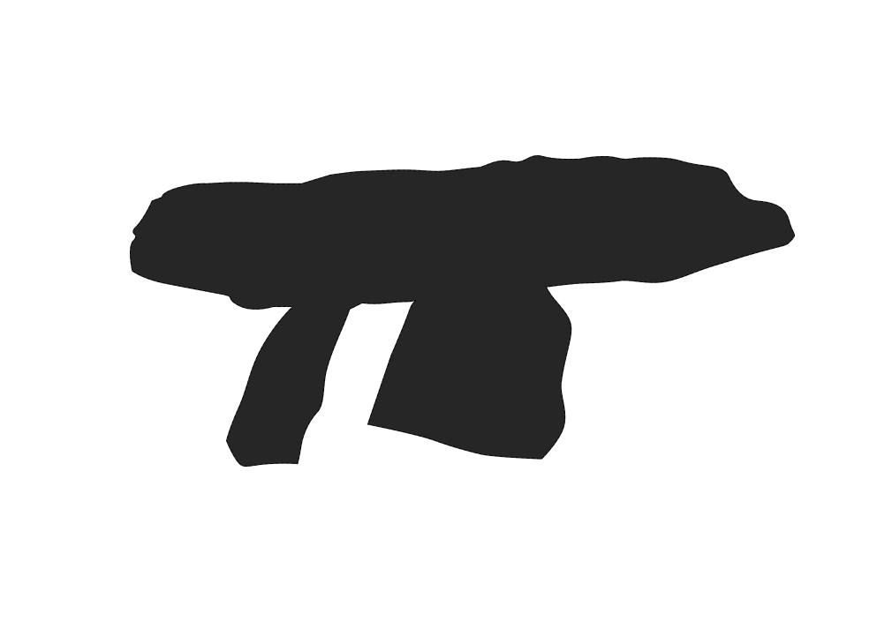
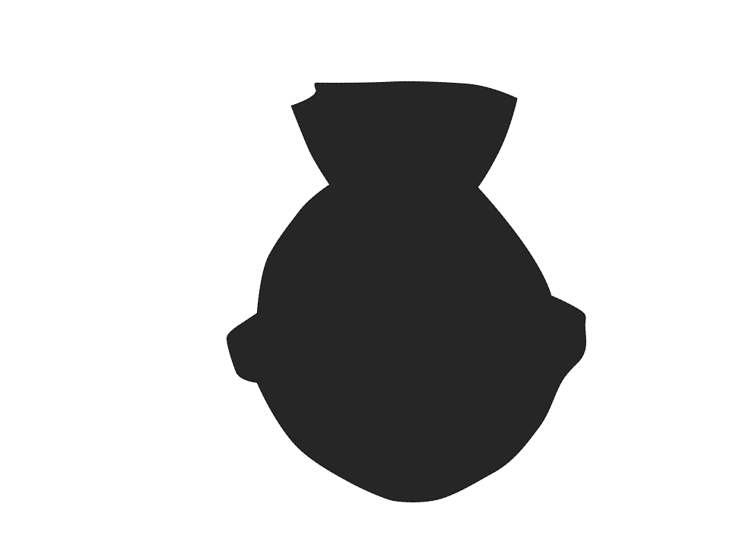
고조선의 3대 유물
비파형 동검
탁자 모양 고인돌
미송리식 토기
Notes:
The area where 비파형 동검, a bronze sword, shaped like an old Chinese instrument, 탁자 모양 고인돌, table-shaped dolmen, and 미송리식 토기 , 미송리 pottery were found, is considered as the 고조선 area.

Slide 12
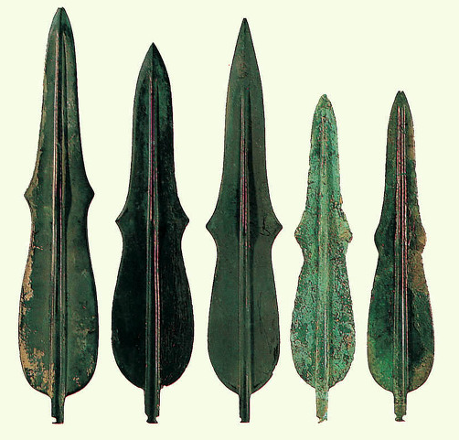
비파형 동검
전쟁 무기
제사 도구
Notes:
This is a 비파형 동검, a bronze sword shaped like an old Chinese instrument. It was used as a weapon and as a ritual tool. It looks similar to the Chinese musical instrument loquat, so it is called a 비파형 동검. The 비파형 동검 was a valuable item, it symbolized power beyond the meaning of a simple weapon.

Slide 13
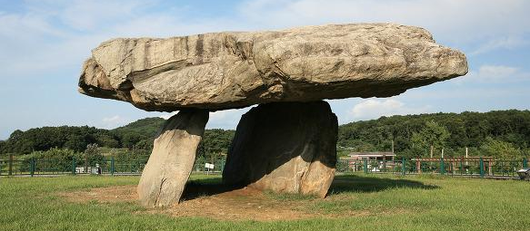
탁자형 고인돌
청동기 시대의 대표적 무덤
지배 계급과 피지배 계급
Notes:
This is a table-shaped dolmen, 탁자모양 고인돌. It is a typical tomb from the Bronze Age. The name 고인돌 comes from a stone that supports large stones. About 40% of the world's dolmen have been found on the Korean Peninsula.

Slide 14
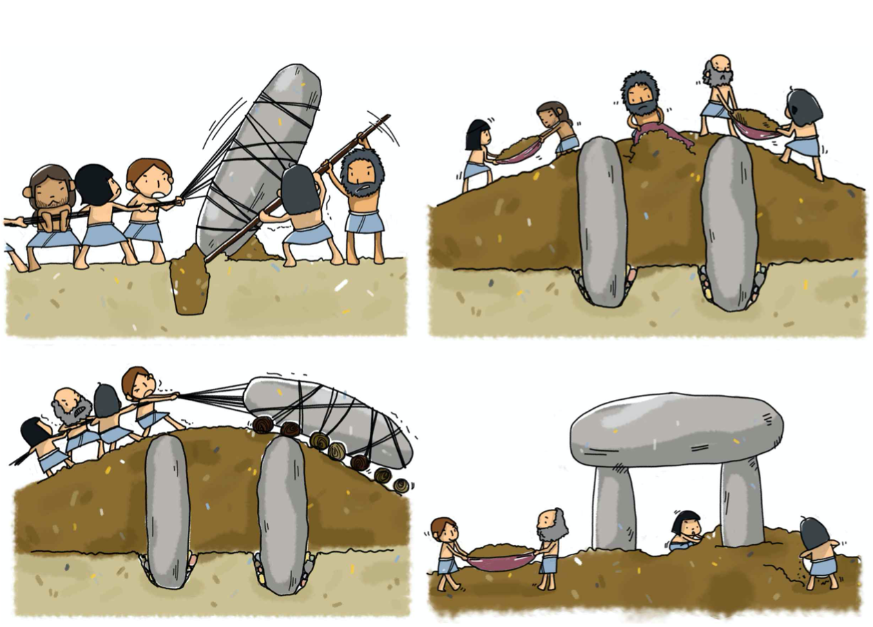
고인돌
만드는 과정
Notes:
This picture shows how to make a dolmen. It required a lot of labor. Through the dolmen, we can see that there were ruling and dominated classes.

Slide 15
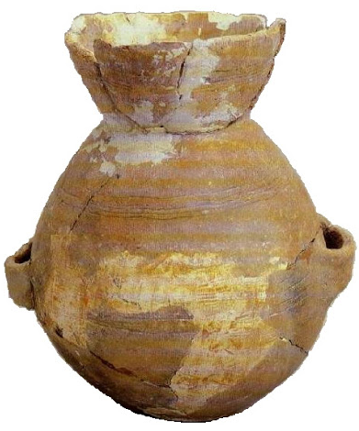
미송리식 토기
      농사를 지으며 정착 생활
      토기 등을 이용하여 음식을
      저장하고 조리
Notes:
This is 미송리식 토기, 미송리 type pottery. As people settled down and farmed, they started to make pottery to store and cook food. Pottery found in 미송리 is a typical Bronze Age pottery, they are called 미송리식 토기.

Slide 16
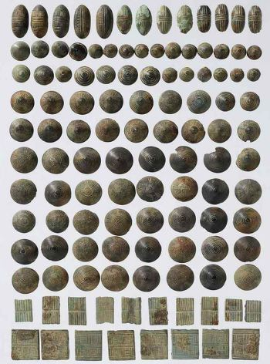
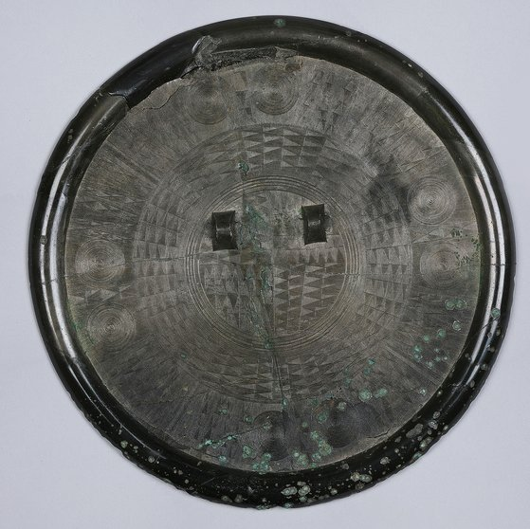
청동 거울/청동 단추
Notes:
Look at these pictures, the picture on the left is bronze mirrors and the picture on the right is bronze buttons. They were used for ritual ceremonies, weapons, and clothing decorations.

Slide 17
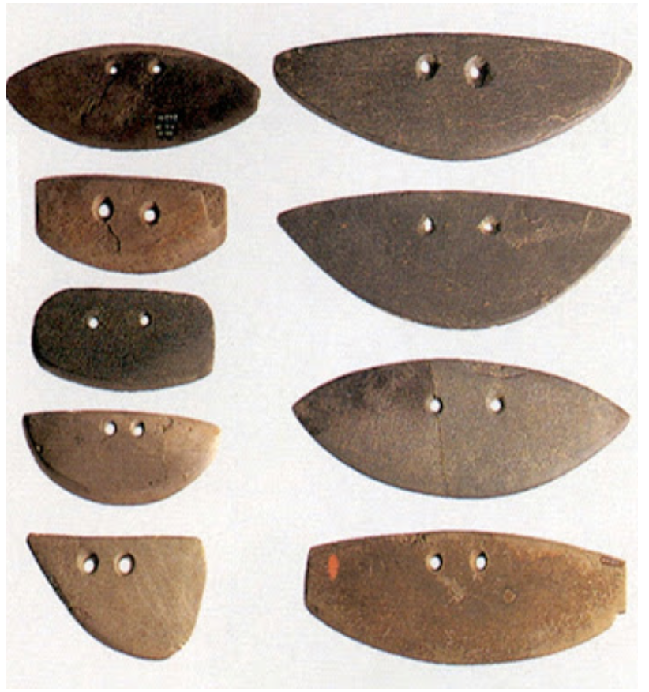
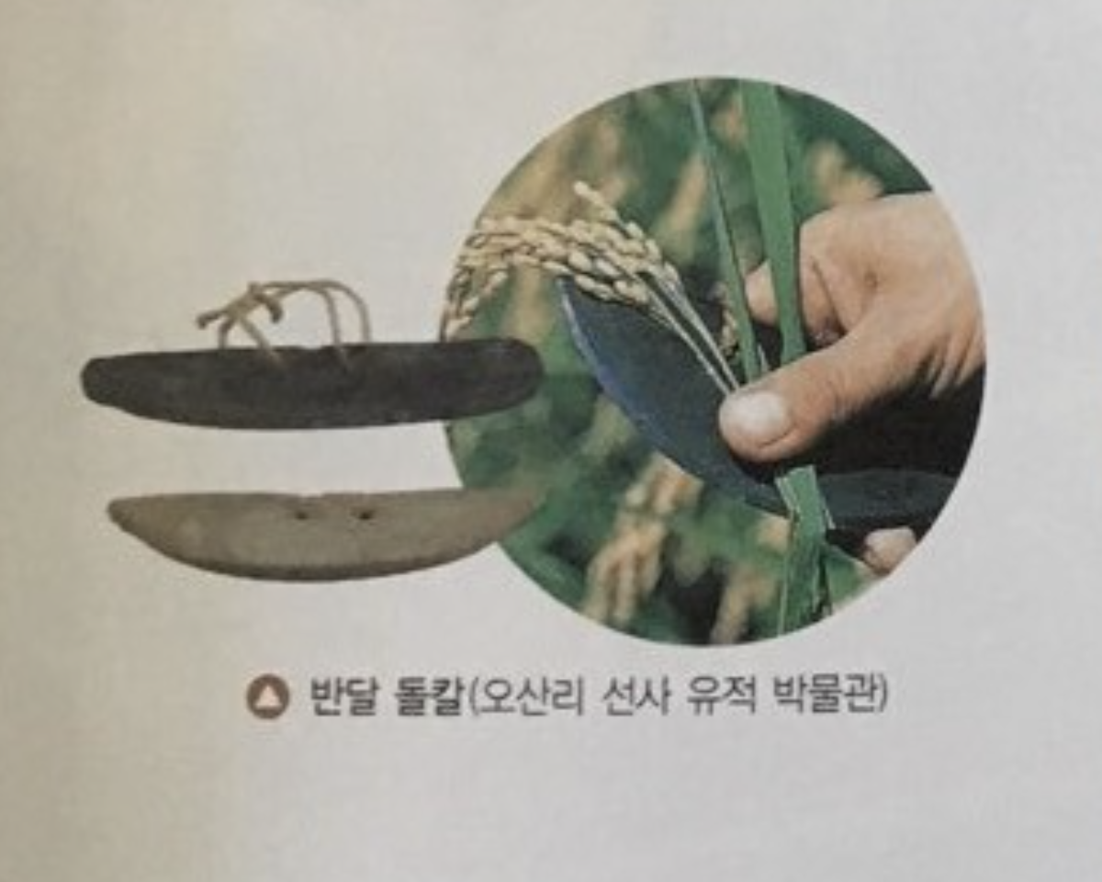
반달 돌칼
Notes:
This is a half-moon shaped stone knife, 반달 돌칼. It was used to cut grain.

Slide 18
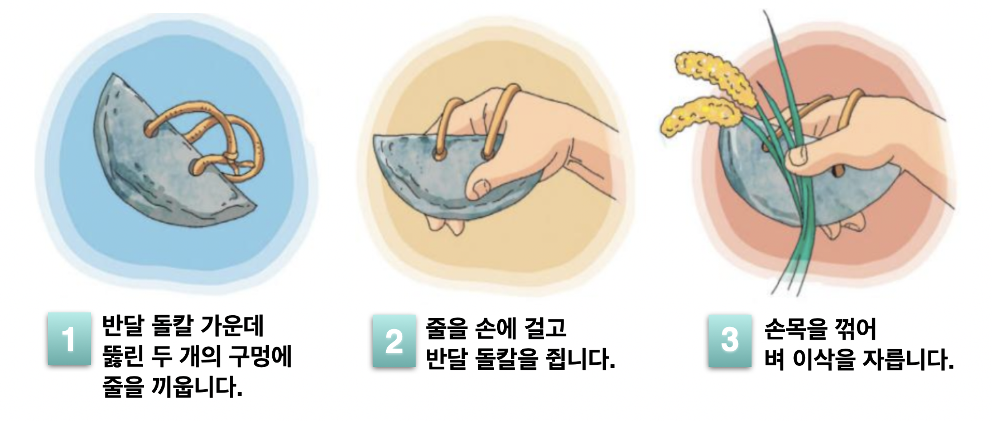
반달 돌칼의 사용 방법
Notes:
This is how to use a half-moon shaped stone knife,반달 돌칼. People put a string through the hole and held it like this.

Slide 19
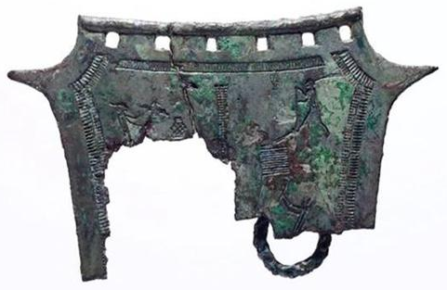
농경문 청동기
Notes:
This is 농경문 청동기, a bronze ware with agricultural drawings on it.

Slide 20
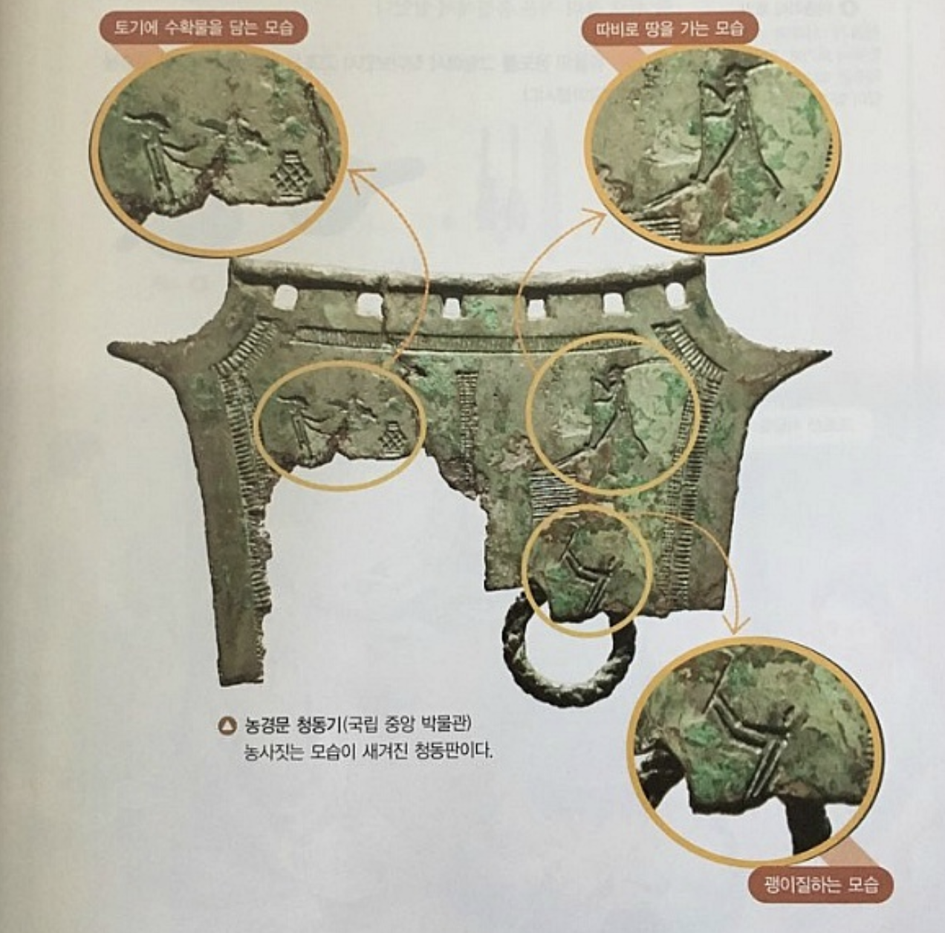
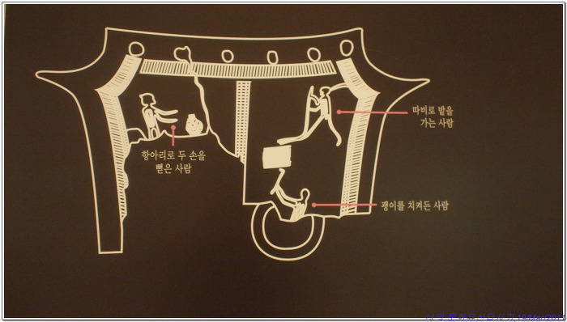
토기에 수확물을 담는 모습
따비로 땅을 가는 모습
괭이질 하는 모습
Notes:
Excluding the broken part, there are three drawings on this 농경문 청동기: the image of putting harvested grain into pottery, plowing the ground, and the use of a hoe can be seen. They are all pictures related to farming, showing that farming was very important in 고조선.

Slide 21
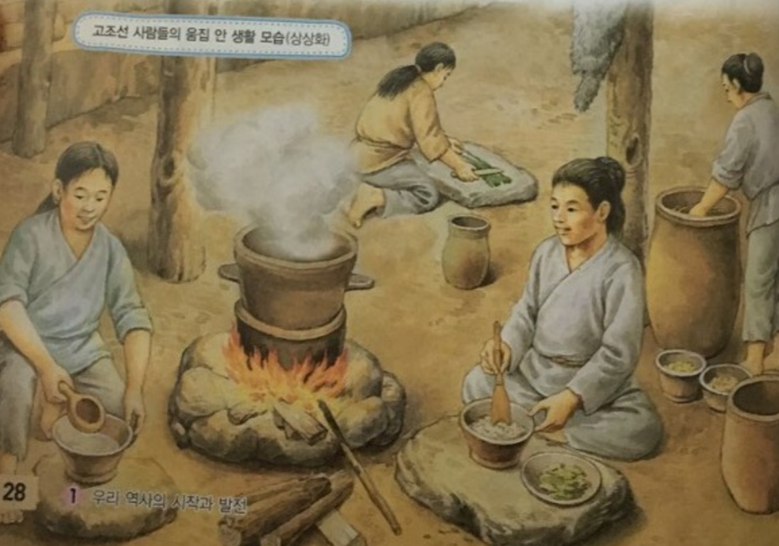
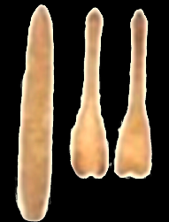
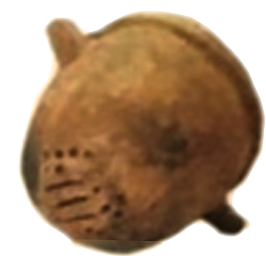
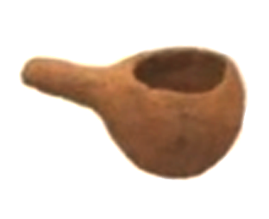
식생활
뼈로 만든 칼/숟가락
시루
국자
Notes:
What kind of food did the people of 고조선 eat? Through the relics, you can see that the people of 고조선 cultivated and ate rice and other grains. They also raised and hunted pigs, cows, horses, sheep, and chickens. They would use the animal skins for leather. They also used wooden bowls and used different types of tableware and cooking utensils.

Slide 22
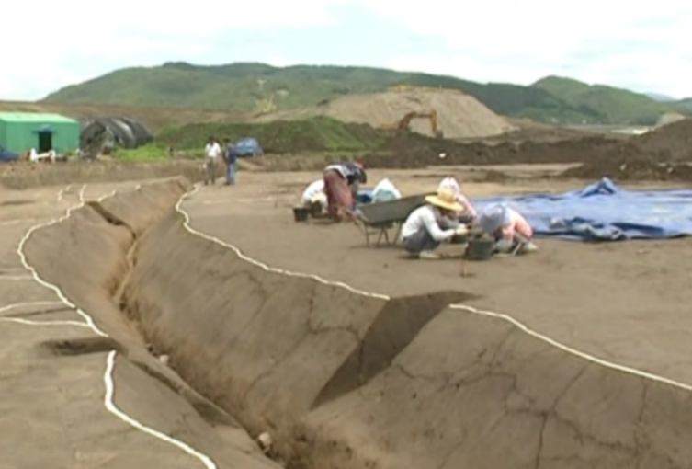
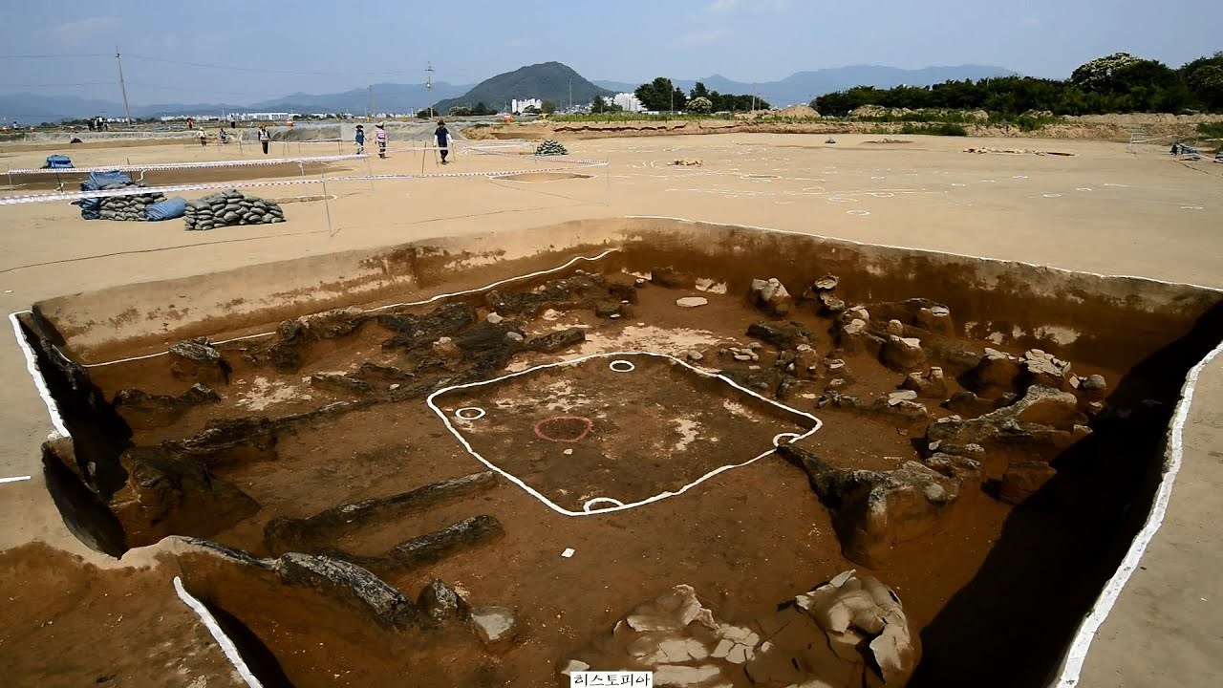
주생활
고조선 집자리
유적 발굴 현장
Notes:
What kind of house did 고조선 people live in? This is a picture of the site of 고조선's house. The house was built by digging the ground in a rectangular shape. It was big enough to accommodate 7-8 people. On the site of the house, a place used for an oven was found. and the oven was used not only for making food, but also for heating. Through this, we know the Korean 온돌 form has existed since 고조선.

Slide 23
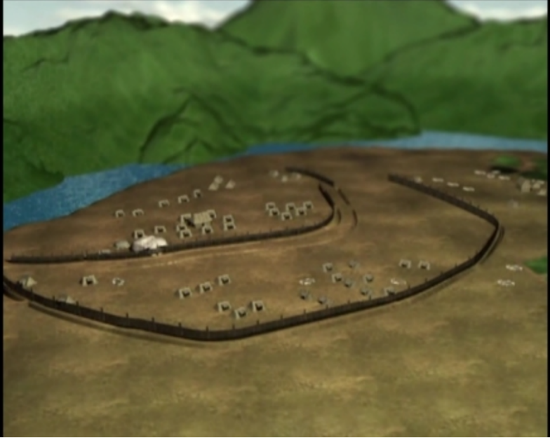
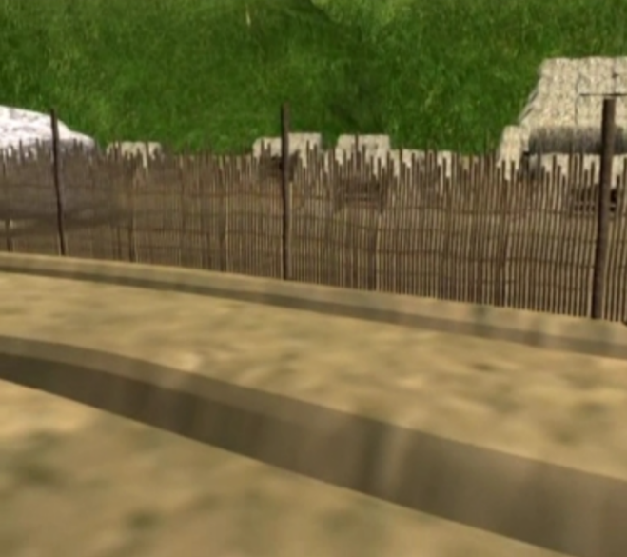
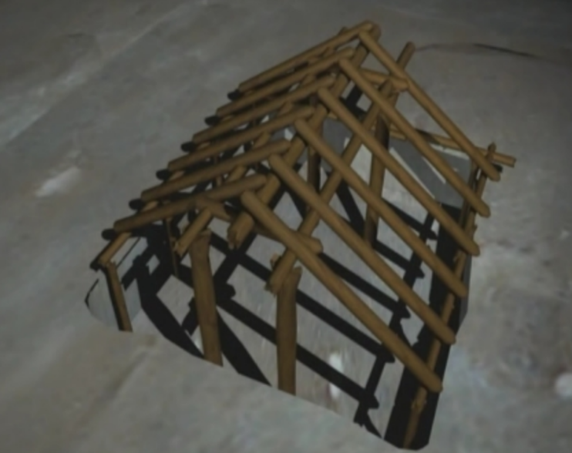

  컴퓨터그래픽으로 복원한 모습
  해자(도랑)
  목책(울타리)
  집
Notes:
The people of 고조선 lived in groups near water with their backs to the mountain. They built fences and ditches around the village to prevent invasion from other tribes. These are pictures restored with CG.

Slide 24
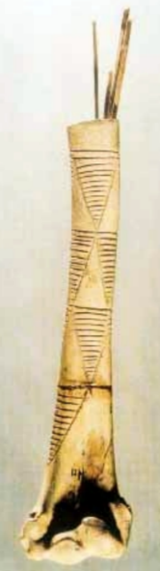
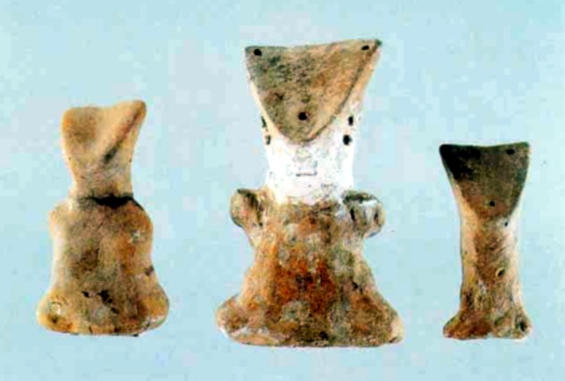
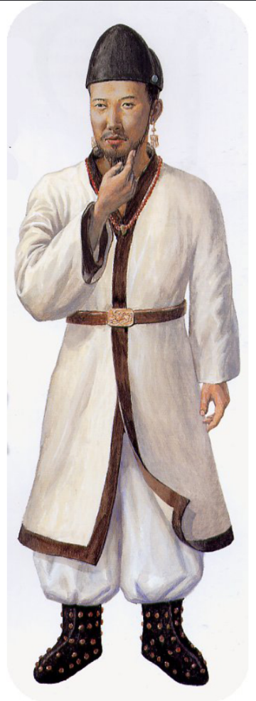
의생활
바늘통(서포항 유적)
남자 모양 흙인형(서포항 유적)
고조선을 계승한 부여의 복식
Notes:
Look at these pictures. The first picture is a needle box. 고조선 people kept needles in a bone box. We can tell that they thought making clothes was very important by looking at this bone needle box. The picture in the middle is of a clay doll wearing a hat. It seems that the people of 고조선 enjoyed wearing hats. The photo on the right is an outfit the 부여 people inherited from 고조선. Since it is a country that inherited 고조선, the clothes of the people of 고조선 would be similar.

